Slide 1
Autonomous Physics-Based Modeling of Retention Loss in 3-D NAND Flash Memory in Cryogenic condition Myung Jin

Slide 2
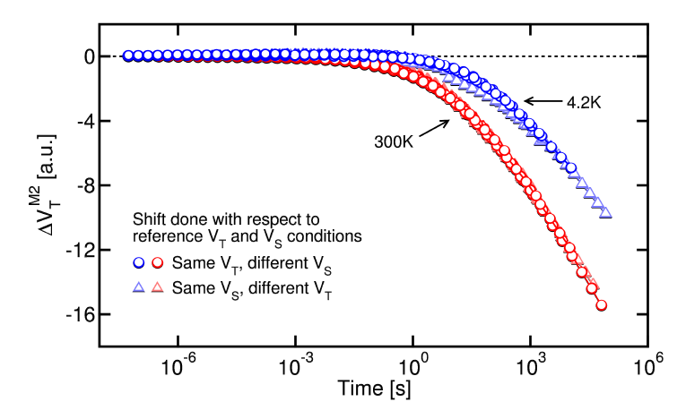
(Remind) Cryogenic and Detrapping
Measurement (Refaldi, IRPS 2025)
Cryogenic condition (~ 4.2K) : physical separation of detrapping effect
Separation of detrapping effect measurement

Slide 3
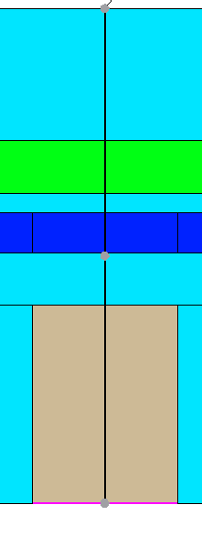
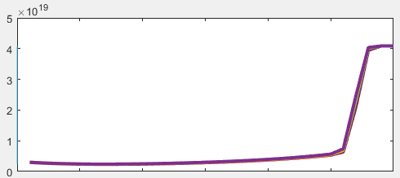
Cryogenic and Detrapping
TCAD Simulation: eTrappedCharge extraction
ch
WL
n_{t_CTN} extraction
TCAD simulation
eTrappedCharge for radial slice
TCAD calibration to Measurement (Time scale calibration)
for every time span
(t = 1e-11 ~ 1e9 [s] )
Measurement – TCAD Calibration
TCAD – Autonomous Model Comparison

Slide 4
Cryogenic and Detrapping
TCAD & measurement showing good time scale match (used scale: 3/6/8 [nm])
Note that measurement ΔV_{t} is in A.U., therefore only time sclae calibration was done

Slide 5
Autonomous Modeling & Result
TCAD – model Matching
TOX variation
3/3.5/4/4.5/5 [nm]
Well match with TCAD - model

